Slide 1

MODERN ERP
•I
••
•
SELECT, lMPLEMENT &USETODAY'SADVANCED BUSlNESS SYSTEMS
Chapter 4: ERP and Process Mapping

Slide 2
Objectives
Recognize the importance of process mapping
Understand the difference between “as is” and “to be” business processes
Become familiar with process map symbols
Distinguish among the various roles used in process mapping
Know the steps involved in mapping a business process

Slide 3
Introduction
As an organization grows, processes can become more complex and over time may become ineffectual.
Eventually, management must take a long hard look at its business processes to determine if they need to be redesigned.
Many times system diagrams are used to illustrate business processes so they are well understood by all.
This chapter focuses on one system diagramming method, the process map, which is widely used in conjunction with ERP implementations and BPR and BPI initiatives.

Slide 4
Systems Diagrams
Systems Diagram - a graphical representation of systems
Flowcharts
ER Diagrams
Other techniques
Basic Purposes for Systems Diagram
  Describing business processes
  Assessing internal control procedures
  Evaluating, designing, or changing information systems

Slide 5
Importance of Systems Diagramming
Often, it is easier to show how something works or how ideas or events are connected by drawing a diagram of it rather than writing a narrative or trying to explain it verbally.
Often your audience has an easier time thinking systematically and logically about a problem that has been illustrated.
It’s important for business professionals to be able to read SDs—to extract information from them and interpret what that information means. It is also important to be able to draw SDs to capture ideas and interpretations of a complex situation.

Slide 6
Process Maps
A process map is a graphical technique that documents inputs, outputs, activities, and decision points in order to effectively tell the reader the step-by-step procedures for a specific business process.
A process map, also known as a cross-functional flowchart or swim lane diagrams, is used by many organizations seeking to analyze, design, and improve business processes.
This SD technique divides a process into a series of steps, or
activities, and identifies the role responsible for each step.
A role is the party responsible for an activity in the process and can be an external entity, such as a customer, supplier, or business partner, or an internal entity, such as a customer service representative or a purchasing manager.

Slide 7
Process Maps
Process maps allow the reader to understand how the process is currently operating.
Additionally, they enable the reader to think about how the process can be improved.
The first type of map is the “as is” process map. Mapping out current processes will help a project team develop requirements for an ERP system and make necessary changes to their processes. For ERP implementations, the “as is” map will be used as the starting point for mapping the existing processes into configurations of the ERP system. Processes will undoubtedly need to be changed to match the best practices in the ERP software.
The second type of process map, the “to be” process map, is a visual representation of the redesigned process, which is more efficient and effective. This future-state process is developed to reflect changes that need to be made to the process.

Slide 8
Process Maps
Benefits:
Defining the "as is" business process and clarifying the changes necessary to transform the present process into the "to be" process.
Determining whether "as is" measures are appropriate
Promoting awareness of employees' responsibilities
Highlighting workflow inefficiencies
Orienting and training new employees or retraining existing employees
Pinpointing internal controls that need to be tested during an audit
Serving as an integral part of the company’s policies and procedures documentation

Slide 9
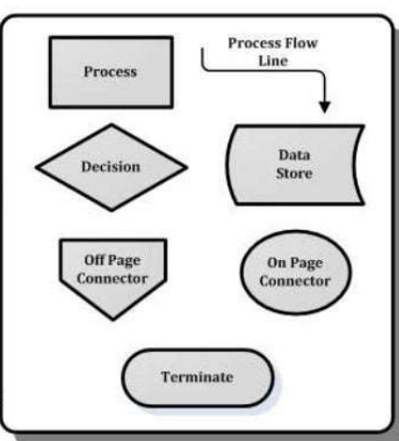
Process Map Symbols
Activities (or events): transform inputs into outputs, depicted in process maps with rectangles.
Decision points: yes/no (positive/negative) outcome that depicts the alternatives. [diamonds].
Process flow lines: [Directional arrows ] connect symbols and are labeled with the type of information flowing into / out of the activities
Data stores: support the process
Termination: points at which the process ends
On-page connector:[circles] reduce clutter on a page
Off-page connector: when processes span multiple pages
,
•

Slide 10
Gathering Information for a Process Map
Group interview method - all people involved in the process are interviewed as a group
  Employs a skilled facilitator to promote and focus the discussions, questioning conventional wisdom and providing an unbiased, objective point of view.
  It is usually more effective than the following two methods
One-on-one interview method - each person involved in the process is interviewed separately
  Less effective than the group interview method
The self-generate method - is used when the preparer personally knows the process. He or she can draw a preliminary process map and then ask others who are knowledgeable about the process to give their input on its completeness and accuracy. This method is typically faster than the other methods because it involves less people.

Slide 11
Process Mapping Roles
Process mapping is best performed by a team of people, including those who actually perform the processes as they currently are. It should be a small team—no more than five or six.
it should include some people who are familiar with process mapping and ERP.
The following key roles are generally employed during process mapping:
      Process map facilitator – Promotes and focuses the discussions and provides an unbiased, objective point of view.
      Process owner – Maintains responsibility for the proper completion of process steps and has authority over the process, its interfaces, and the changes that will take place.
      Subject matter expert – Knows the process intimately and provides knowledge and expertise.
      Process implementer – Executes recommendations and implements changes such as new procedures and systems.
      Process evaluator – Tests the “to be” process and helps determine new metrics for its evaluation.

Slide 12
Steps for Drawing Process Maps
Have a defined purpose for mapping a process and explain it to those participating
Identify the scope of the process
Determine the roles participating in the process
  Roles become horizontal bands called swim lanes
Determine the trigger, the event that must occur to get the process started
  The trigger should be in the first swim lane
Organize the process map so that activities move either to the right, down, or up.
Use active verbs for activity descriptions such as “enter,” “inspect,” or “input.”
Do not combine completely separate/unrelated steps in an activity.
Write a description of the data, information, or physical flow on the process flow line.
Ask questions within the decision symbols. Label the decision outcomes with “yes” or “no” or similar.
Capture information about which systems or ERP modules support the process and note their names within activity or decision symbols.

Slide 13
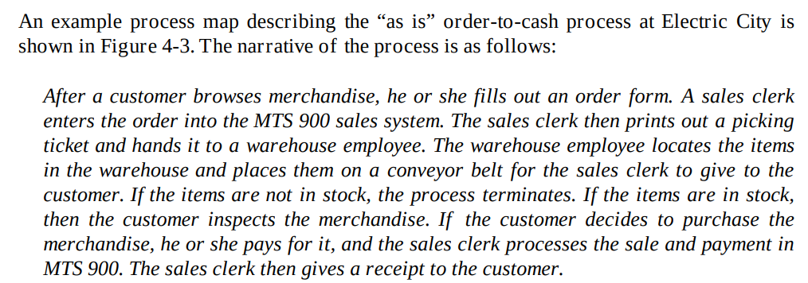
Process Map Example – Electric City

Slide 14
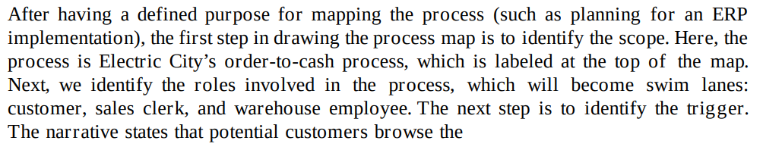
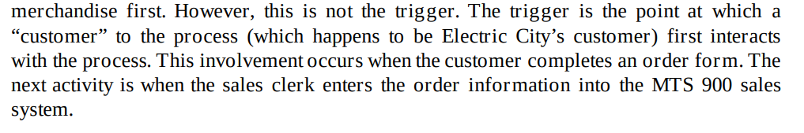
Steps for Drawing the Electric City Process Map

Slide 15
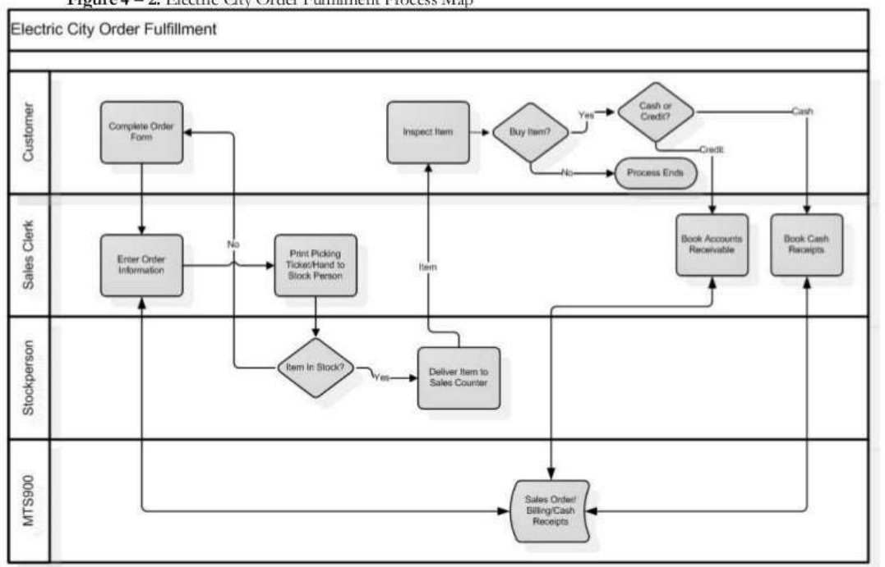
Steps for Drawing the Electric City Process Map

